Slide 1

ETL and Analysis applied to Meetup* Streams
What ideas are cities and communities across the US curious about?
Karin Brodd
Chandler McCann
Natarajan Shankar
Dan Watson
*Meetup is an online social Networking portal that facilitates group meetings. Meetup brings people together in thousands of cities to do more of what they want to do in life.

Slide 2
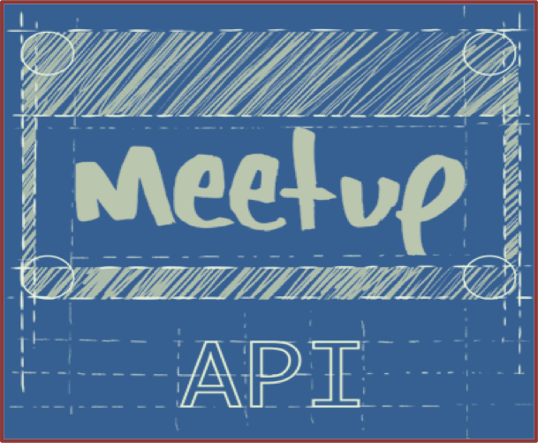
Data Acquisition
Browser/Client authenticated with OAuth
Streaming between server and API key protected client
JSON formatted data predominant, other encodings available
Event descriptors are pushed into stream in real-time
Client can search and log Meetups by zip code, radius, groups, and number of members, allowing for Filtering
RSVP API available for parsing
Rich event information
Date, time, location, number of members attending, number of guests attending
Local storage in SQL-capable database, to support merging and aggregation
Notes:
Excellent documentation for API
https://www.meetup.com/meetup_api/

Slide 3

Anticipated Challenges
This project is potentially programmatically intense but the core focus of this project will specifically be kept to ETL infrastructure
Designing a system that can ingest live streaming data for storage, processing, and serving is quite involved
Potentially multiple streaming sources: RSVPs, Events, and comments, will need to be processed efficiently
May want to incorporate data from other non-streaming APIs
Transforming JSON document stream from API into schema usable for answering research question is non-trivial
Processing unstructured portions of data for additional features, e.g.: comments, event descriptions is critical to solution implementation
Text processing is critical to decoding the streams and will need complex interpretative approaches

Slide 4

Execution Overview
Week 6 -8 - Acquisition and storage strategy
Research question refinement
API call plan (frequency, locations, topics)
Storage Plan
Week 9-10 - Acquisition and Storage Test
Pilot AWS solution and data pipeline
Data cleansing automation test
Week 10-12- Data Storage and Analysis Test
Bulk data storage
Analysis algorithm test and refinement
Week 13 on- Analysis and close-out
Complete analysis and results summary

